Slide 1
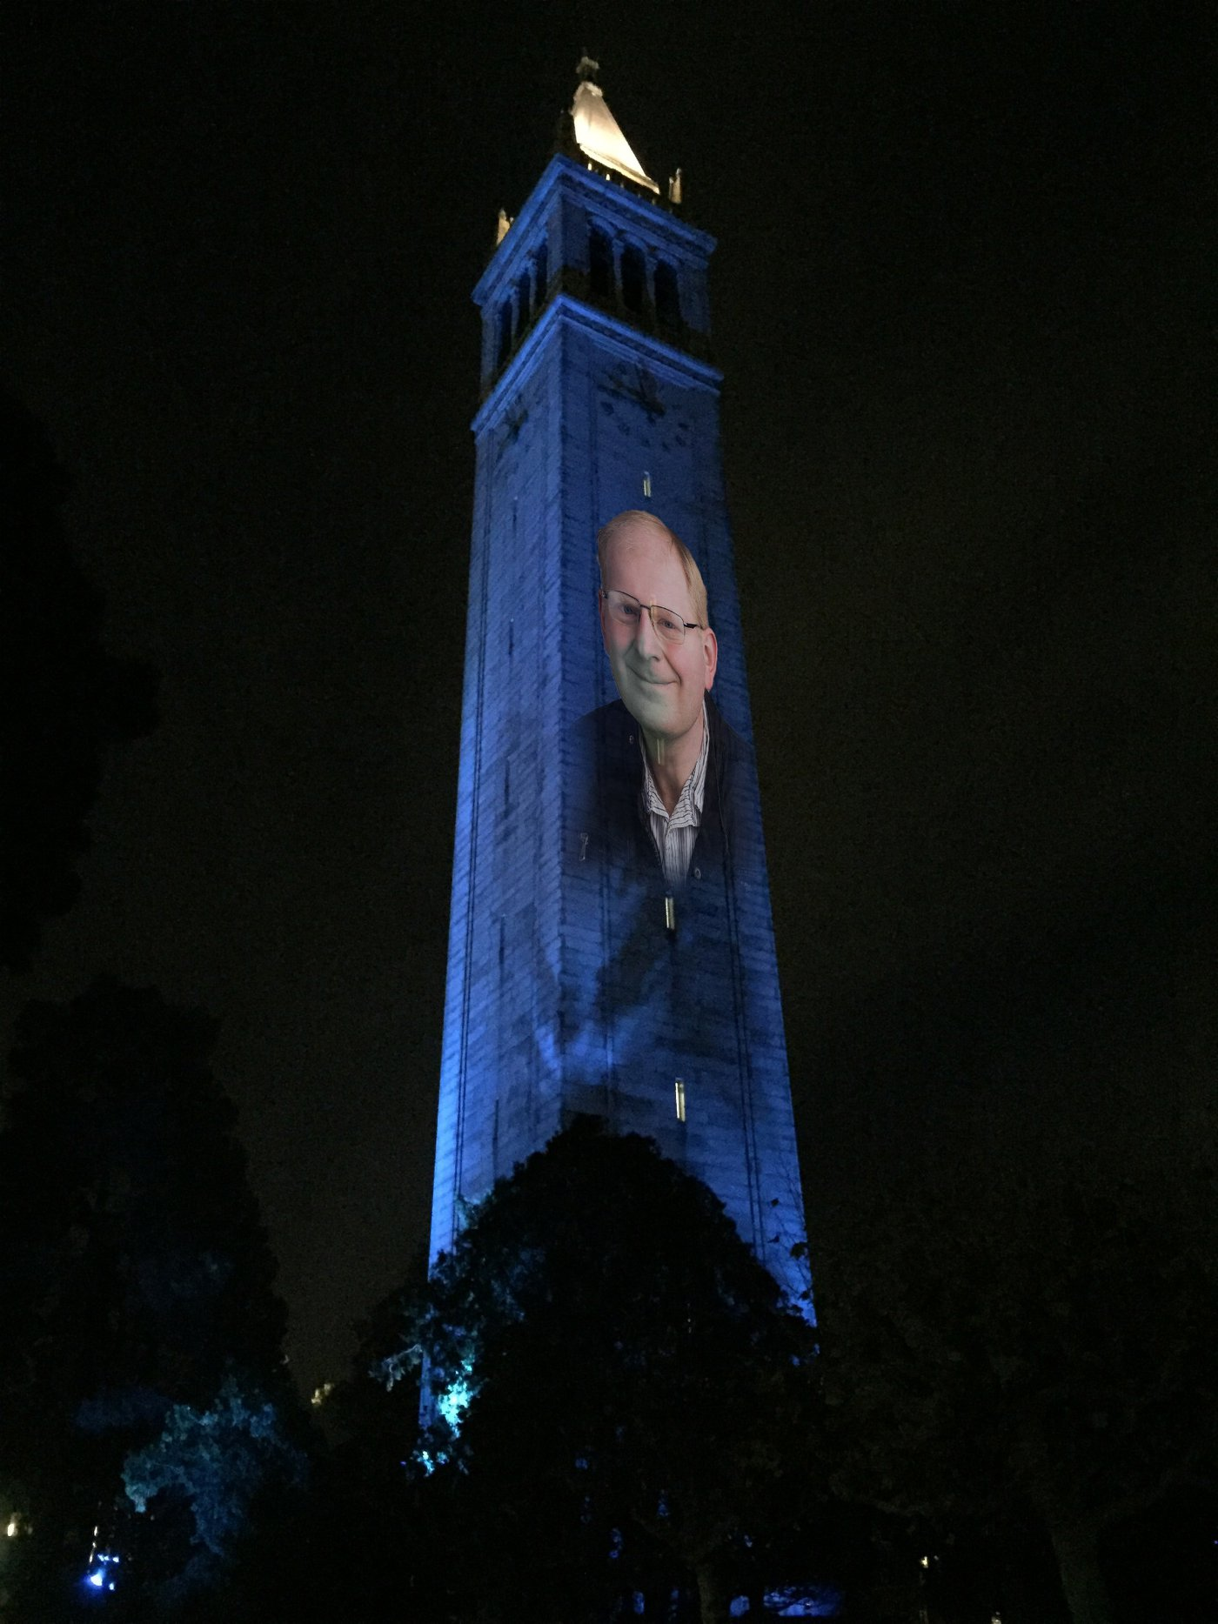
Homographies and Panoramas
with a lot of slides stolen from
Steve Seitz and Rick Szeliski
© Andrew Campbell
CS180: Intro to Computer Vision and Comp. Photo
Alexei Efros, UC Berkeley, Fall 2024

Slide 2
Project 4 out today!

Slide 3
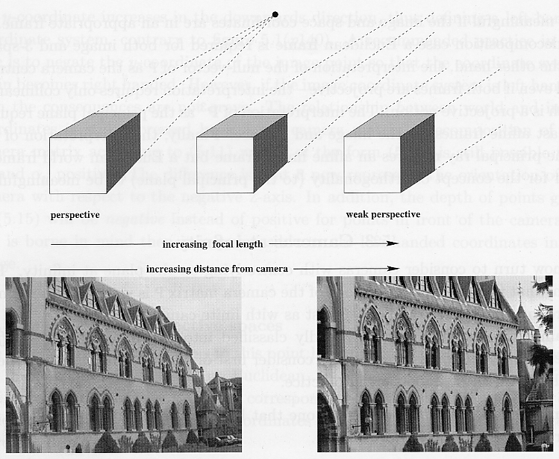
Recap
From Zisserman & Hartley

Slide 4
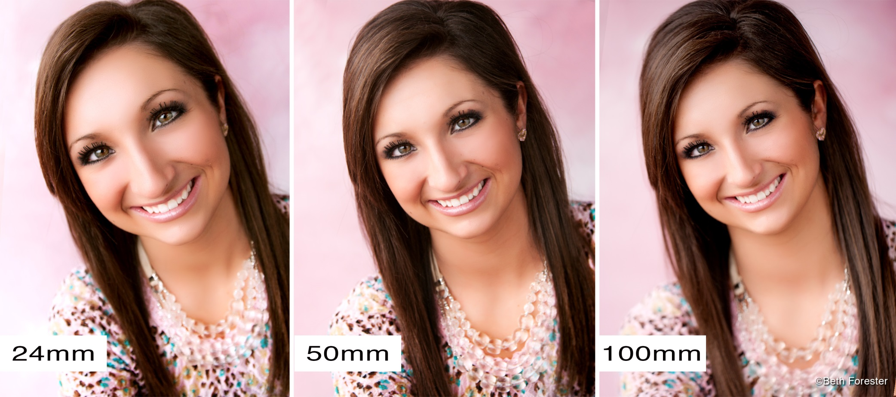
Focal length / distance in portraiture
Notes:
exaggerated perspective effects on the nose, step back and zoom in.

Slide 5
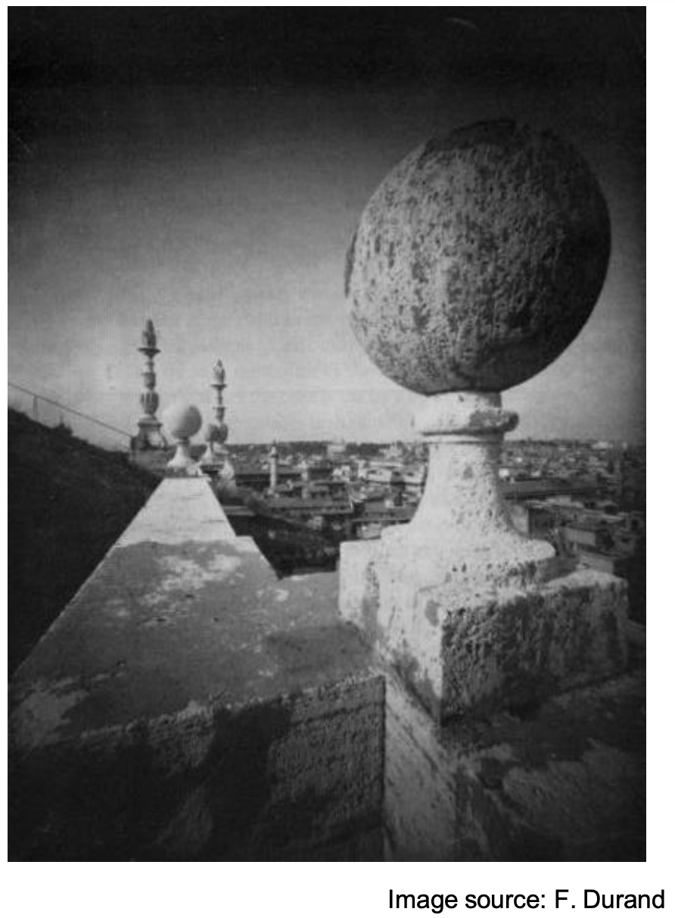
Perspective Distortion
Not due to lens flaws

Slide 6
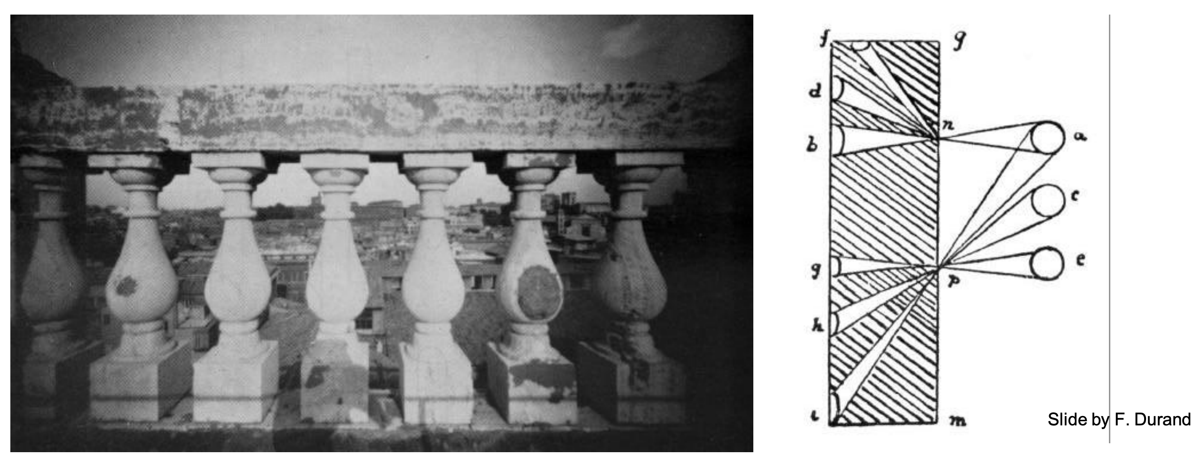
Problem pointed out by Da Vinci
The exterior columns appear bigger
Image Plane

Slide 7
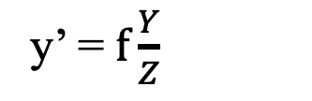
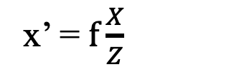
Perspective Distortion
Recall Perspective Projection:
x’ = $f\frac{X}{Z}$
y’ = $f\frac{Y}{Z}$
≠
Image Plane
COP

Slide 8
Perspective Distortion
With a spherical projection plane
≠
Image Plane
COP
Notes:
What is the effect as the object moves to the right (in the limit)?
What is the effect on the curved image plane?

Slide 9
Perspective Distortion
With a spherical projection plane
≠
Image Plane
COP
Notes:
What is the effect as the object moves to the right (in the limit)?
What is the effect on the curved image plane?

Slide 10
Perspective Distortion
Less noticeable with long focal length (i.e. you see distortion more with wide-angle camera)
Image Plane
COP

Slide 11

Perspective Distortion
It’s about the change in depths
Image Plane
COP
But this is a very special case..
Notes:
why is it special?

Slide 12

Perspective Distortion
More likely..
Image Plane
COP

Slide 13
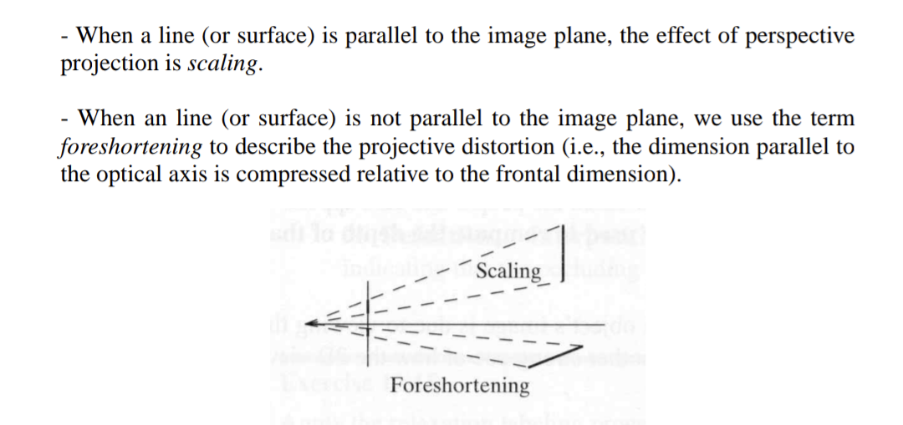
Foreshortening
Image Plane
COP

Slide 14
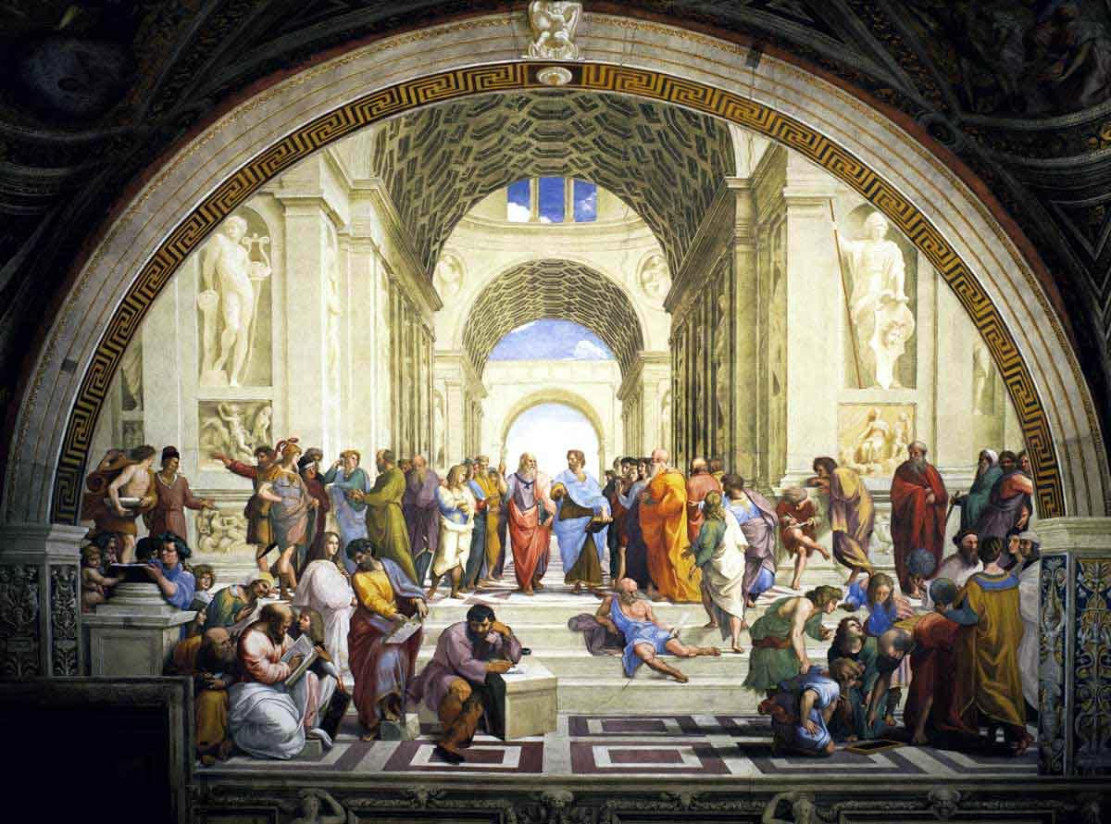
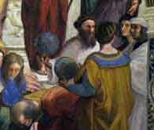
Renaissance Painters’ solution
“School of Athens”, Raffaello Sanzio ~1510
Give a separate treatment to different parts of the scene!!

Slide 15
Personalized projections
“School of Athens”, Raffaello Sanzio ~1510
Give a separate treatment to different parts of the scene!!

Slide 16
Our visual world as a set of light rays

Slide 17
What do we see?
3D world
2D image
Figures © Stephen E. Palmer, 2002

Slide 18
What do we see?
3D world
2D image
Painted
backdrop

Slide 19
On Simulating the Visual Experience
Just feed the eyes the right data
No one will know the difference!
Philosophy:
Ancient question: “Does the world really exist?”
Science fiction:
Many, many, many books on the subject, e.g. slowglass from “Light of Other Days”
“Latest” take: The Matrix
Physics:
Slowglass might be possible?
Computer Science:
Virtual Reality
To simulate we need to know:
What does a person see?

Slide 20
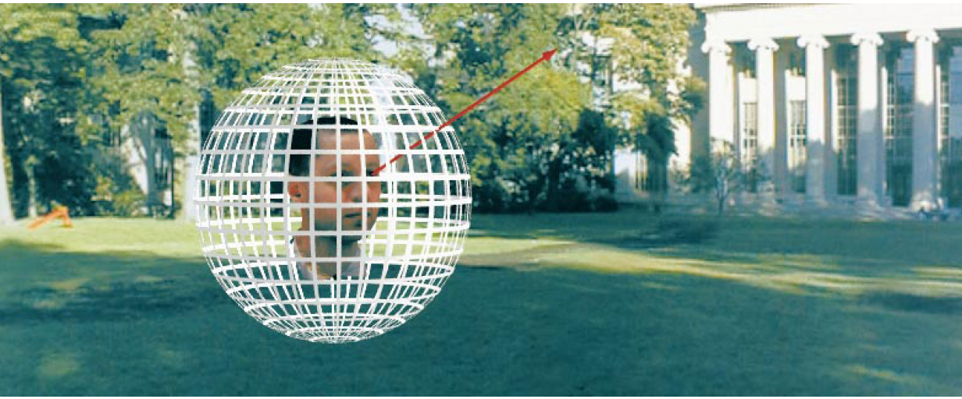
The Plenoptic Function
Figure by Leonard McMillan
Q: What is the set of all things that we can ever see?
A: The Plenoptic Function (Adelson & Bergen)
Let’s start with a stationary person and try to parameterize everything that he can see…

Slide 21
Grayscale snapshot
P(θ,φ)
is intensity of light
Seen from a single view point
At a single time
Averaged over the wavelengths of the visible spectrum
(can also do P(x,y), but spherical coordinate are nicer)

Slide 22
Color snapshot
P(θ,φ,λ)
is intensity of light
Seen from a single view point
At a single time
As a function of wavelength

Slide 23
A movie
P(θ,φ,λ,t)
is intensity of light
Seen from a single view point
Over time
As a function of wavelength

Slide 24
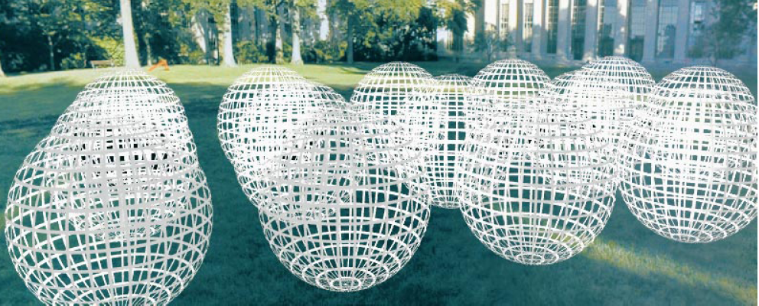
Holographic movie
P(θ,φ,λ,t,V_{X},V_{Y},V_{Z})
is intensity of light
Seen from ANY viewpoint
Over time
As a function of wavelength

Slide 25
The Plenoptic Function
P(θ,φ,λ,t,V_{X},V_{Y},V_{Z})
Can reconstruct every possible view, at every moment, from every position, at every wavelength
Contains every photograph, every movie, everything that anyone has ever seen! it completely captures our visual reality! Not bad for a function…

Slide 26
Sampling Plenoptic Function (top view)
Just lookup -- Quicktime VR

Slide 27
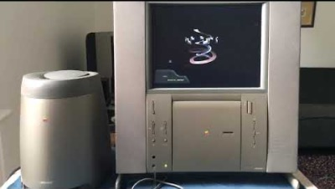
QuickTime VR 1995

Slide 28
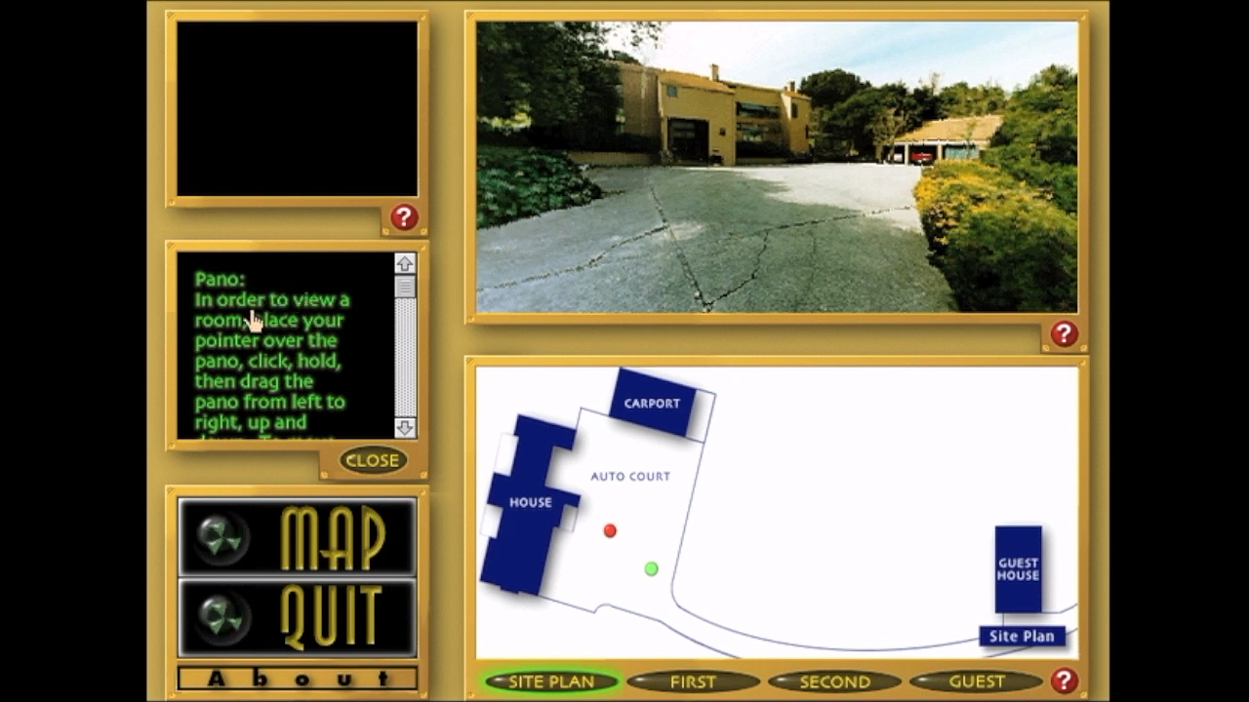
Apple Quicktime VR

Slide 29
What is an image?
Slide by Rick Szeliski and Michael Cohen
Notes:
what is the maximum information stored in an image? Even if you had the entire pencil (transparent back of head) all you have is a 2D structure

Slide 30
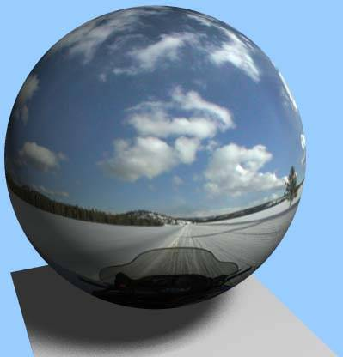

Spherical Panorama
All light rays through a point form a ponorama
Totally captured in a 2D array -- P(θ,φ)
Where is the geometry???
Notes:
This is the fundamental idea behind spherical panorama: Normal image (with a transparent skull), nothing more than theta phi, even tho it looks cool

Slide 31
https://www.360cities.net/curated_sets/90-new-year's-eve-celebrations
https://www.360cities.net/image/new-year-in-prague-2015-2016?curated_set=90
Notes:
how to break this illusion?

Slide 32
What is an Image?
Notes:
image is just a subset of the rays from the pencil

Slide 33
A pencil of rays contains all views
real
camera
synthetic
camera
Can generate any synthetic camera view
as long as it has the same center of projection!

Slide 34
Image reprojection
Basic question
How to relate two images from the same camera center?
how to map a pixel from PP1 to PP2
PP2
Answer
Cast a ray through each pixel in PP1
Draw the pixel where that ray intersects PP2
PP1
But don’t we need to know the geometry
of the two planes in respect to the eye?
Observation:
Rather than thinking of this as a 3D reprojection,
think of it as a 2D image warp from one image to another

Slide 35
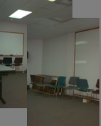
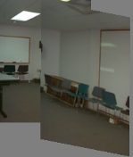
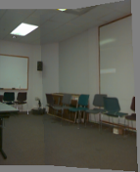
Back to Image Warping
Which t-form is the right one for warping PP1 into PP2?
e.g. translation, Euclidean, affine, projective
Translation
Affine
Perspective
2 unknowns
6 unknowns
8 unknowns

Slide 36
Homography
A: Projective – mapping between any two PPs with the same center of projection
rectangle should map to arbitrary quadrilateral
parallel lines aren’t
but must preserve straight lines
same as: unproject, rotate, reproject
called Homography
PP2
p’
H
p
PP1
To apply a homography H
Compute p’ = Hp (regular matrix multiply)
Convert p’ from homogeneous to image coordinates

Slide 37
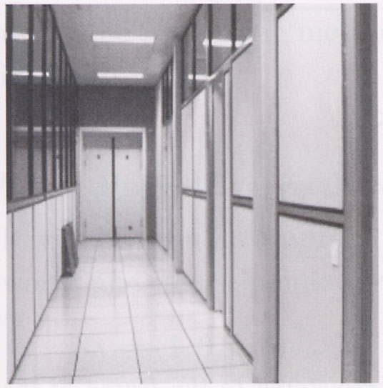
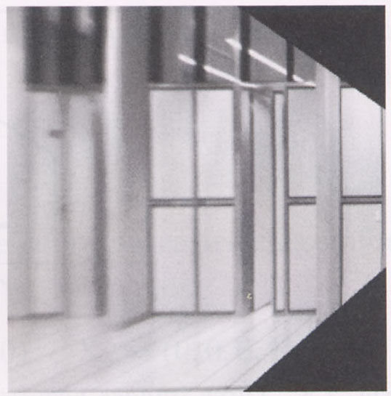
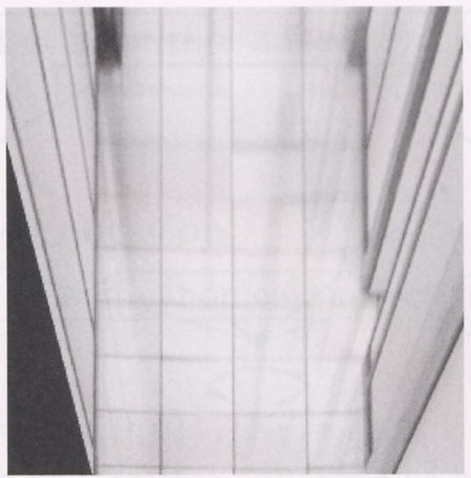
Image warping with homographies
image plane in front
image plane below
black area
where no pixel
maps to

Slide 38
Image rectification
p’
p
To unwarp (rectify) an image
Find the homography H given a set of p and p’ pairs
How many correspondences are needed?
Tricky to write H analytically, but we can solve for it!
Find such H that “best” transforms points p into p’
Use least-squares!

Slide 39
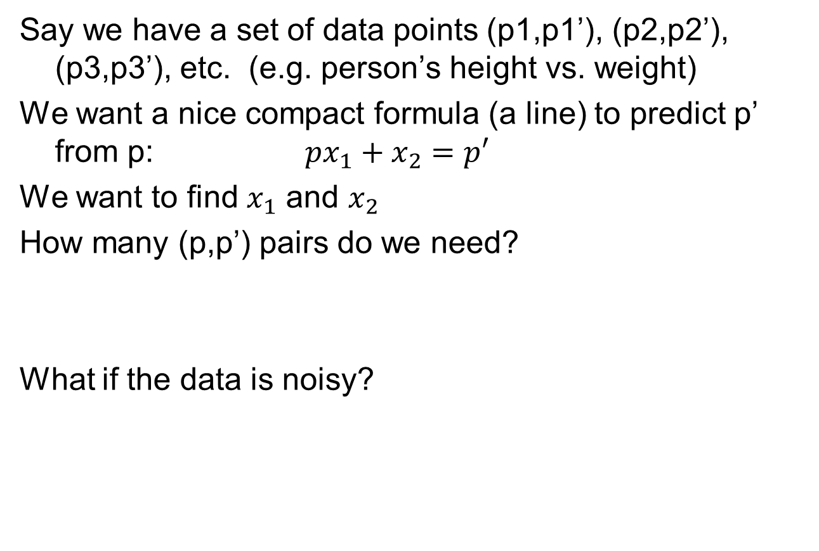
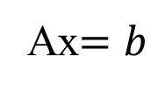
Least Squares Example

Slide 40
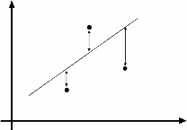
Least Squares Example
overconstrained

Slide 41
Least-Squares
d
Solve:
A x = b
(N,d)(d,1) = (N,1)
Normal equations
A^{T}A x = A^{T}b
(d,N)(N,d)(d,1) = (d,N)(N,1)
Solution:
x = (A^{T}A)⁻¹A^{T}b
A
N
rank(A)≤min(d,N)
assume rank(A)=d
implies rank(A^{T}A)=d
A^{T}A is invertible

Slide 42
Solving for homographies
p’ = Hp
Can set scale factor i=1. So, there are 8 unkowns.
Set up a system of linear equations:
Ah = b
where vector of unknowns h = [a,b,c,d,e,f,g,h]^{T}
Need at least 8 eqs, but the more the better…
Solve for h. If overconstrained, solve using least-squares:
Can be done in Matlab using “\” command
see “help lmdivide”

Slide 43
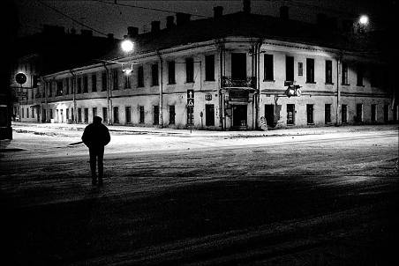
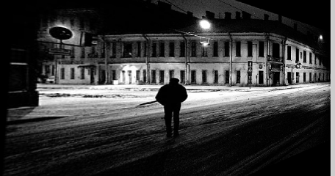
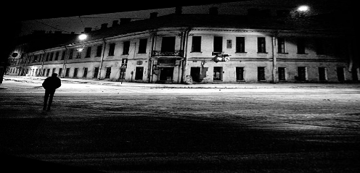
Image rectification
Original image
St.Petersburg
photo by A. Tikhonov
Virtual camera rotations

Slide 44
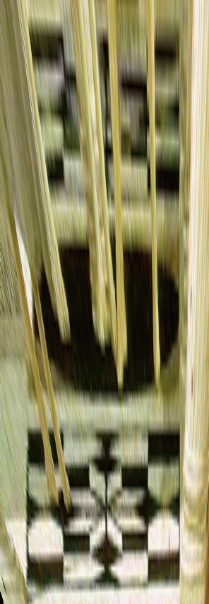
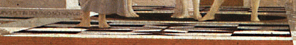
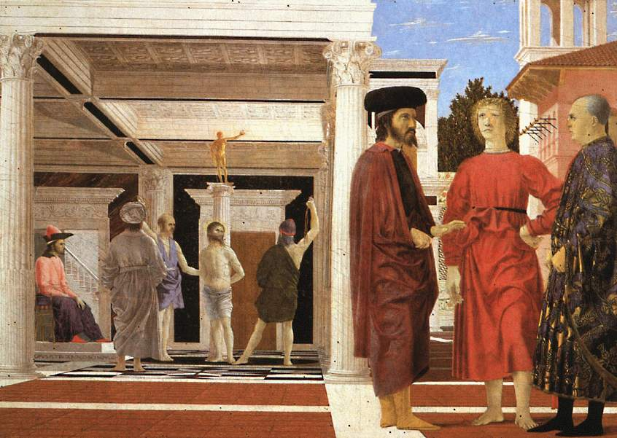
Rectification for Art Analysis
What is the shape of the b/w floor pattern?
Homography
The floor (enlarged)
Automatically
rectified floor
Slide from Criminisi

Slide 45
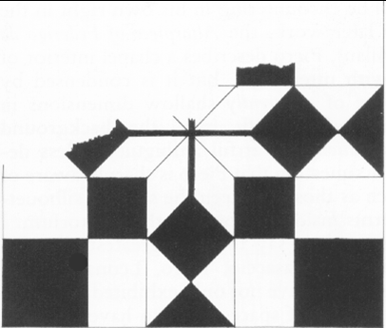
Analysing patterns and shapes
Automatic rectification
From Martin Kemp The Science of Art
(manual reconstruction)
2 patterns have been discovered !
Slide from Criminisi

Slide 46
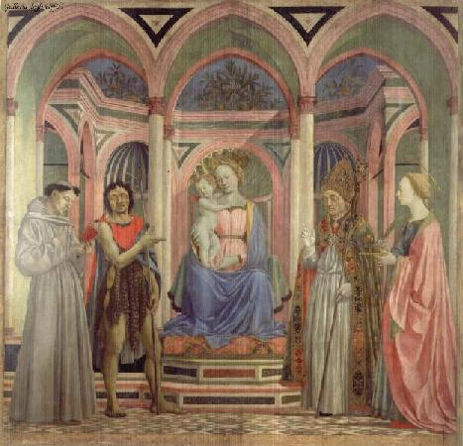
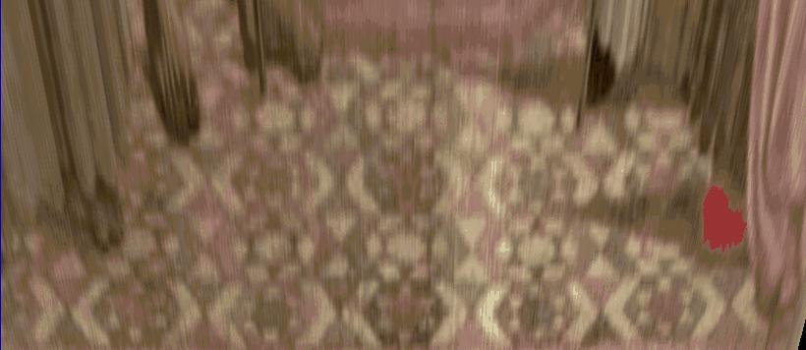
Analysing patterns and shapes
What is the (complicated)
shape of the floor pattern?
Automatically rectified floor
St. Lucy Altarpiece, D. Veneziano
Slide from Criminisi

Slide 47
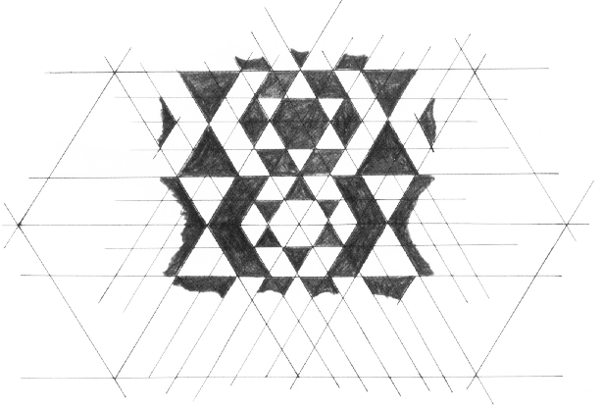
Analysing patterns and shapes
Automatic
rectification
From Martin Kemp, The Science of Art
(manual reconstruction)
Slide from Criminisi

Slide 48
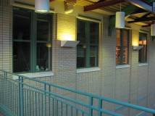
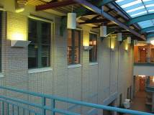
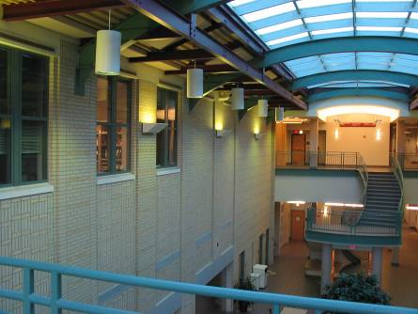
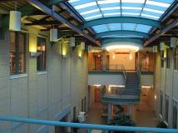
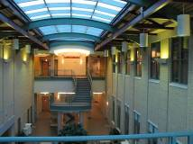
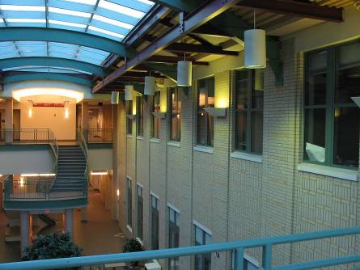
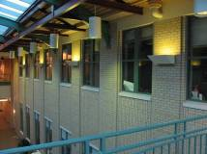
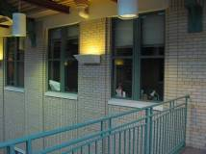
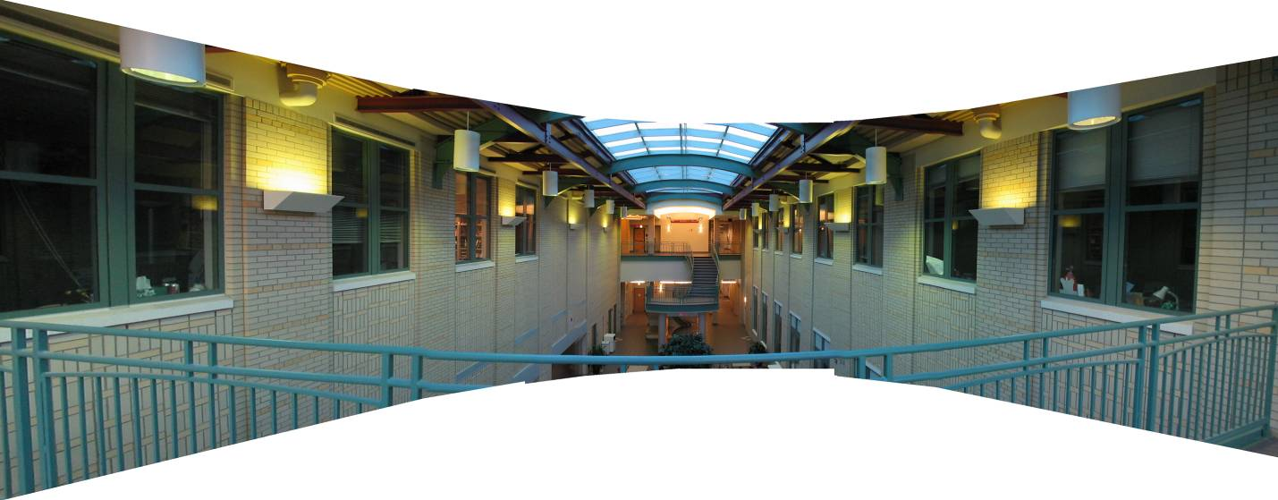
Mosaics: stitching images together
virtual wide-angle camera

Slide 49

Why Mosaic?
Are you getting the whole picture?
Compact Camera FOV = 50 x 35°
Slide from Brown & Lowe

Slide 50
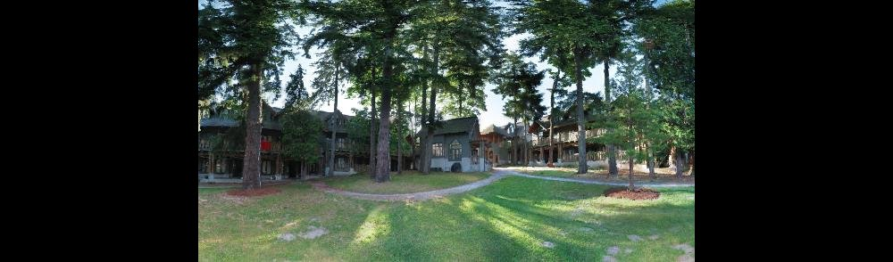
Why Mosaic?
Are you getting the whole picture?
Compact Camera FOV = 50 x 35°
Human FOV = 200 x 135°
Slide from Brown & Lowe

Slide 51
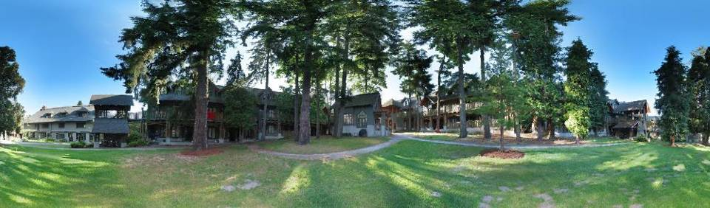
Why Mosaic?
Are you getting the whole picture?
Compact Camera FOV = 50 x 35°
Human FOV = 200 x 135°
Panoramic Mosaic = 360 x 180°
Slide from Brown & Lowe

Slide 52
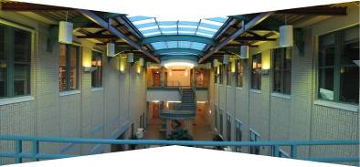
Naïve Stitching
left on top
right on top
Translations are not enough to align the images

Slide 53
Image reprojection
mosaic PP
The mosaic has a natural interpretation in 3D
The images are reprojected onto a common plane
The mosaic is formed on this plane
Mosaic is a synthetic wide-angle camera

Slide 54
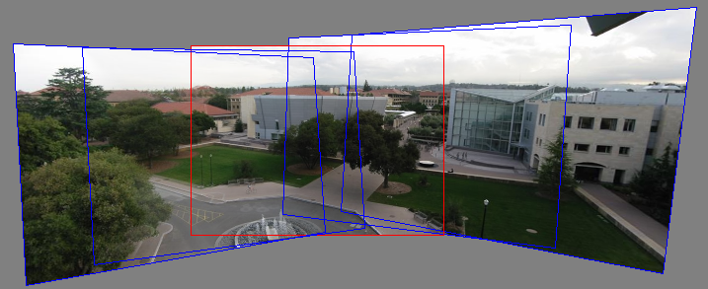
Panoramas
Pick one image (red)
Warp the other images towards it (usually, one by one)
blend

Slide 55
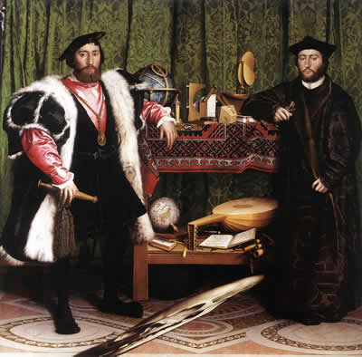
Holbein, The Ambassadors

Slide 56
Programming Project #4 (part 1)
Homographies and Panoramic Mosaics
Capture photographs (and possibly video)
Might want to use tripod
Compute homographies (define correspondences)
will need to figure out how to setup system of eqs.
(un)warp an image (undo perspective distortion)
Produce panoramic mosaics (with blending)
Do some of the Bells and Whistles

Slide 57

Example homography final project

Slide 58
Think about this: When is this not true?
We can generate any synthetic camera view
as long as it has the same center of projection!
real camera
synthetic camera
What happens if there are two center of projection?
(you move your head)

